Slide 1
IPv6 Fanatics
31 October 2025
IMC25 Hackathon

Slide 2
Where does IPv6 performance stand compared to IPv4?

Slide 3
Project Roadmap
IPv6 Adoption per Country
IPv4 vs IPv6 Differences in Performance
  Latency
  Download/Upload Speeds
  Loss Rate

Slide 4
Datasets
M-lab data snapshots from [2025/10/01 - 2025/10/07]
Network Diagnosis Tool:
  Client → AS, Geolocation, RTT, Loss Rates, Throughput Mbps
Cloudflare Speedtest Data:
  Average Latency, Download/Upload bps

Slide 5
IPv6 Activity in the Wild

Slide 6
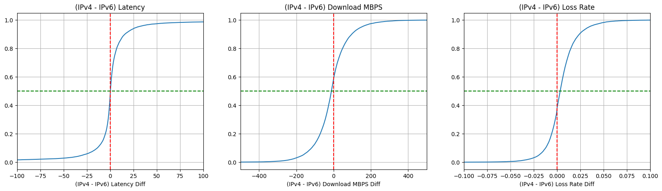
IPv4 vs IPv6 Performance

Slide 7
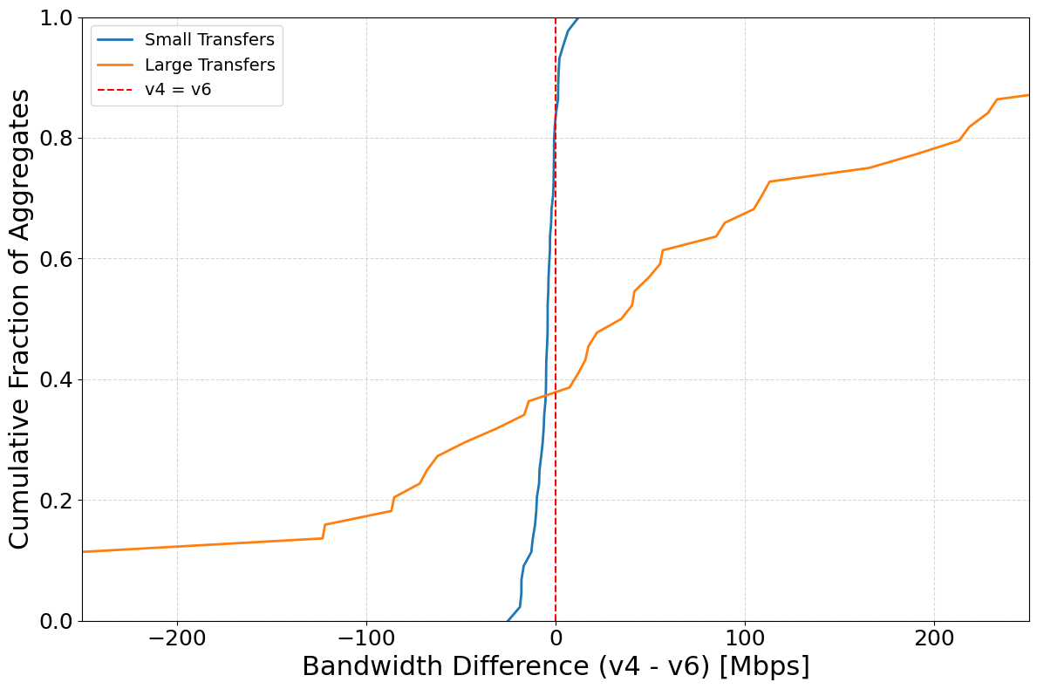

Slide 8
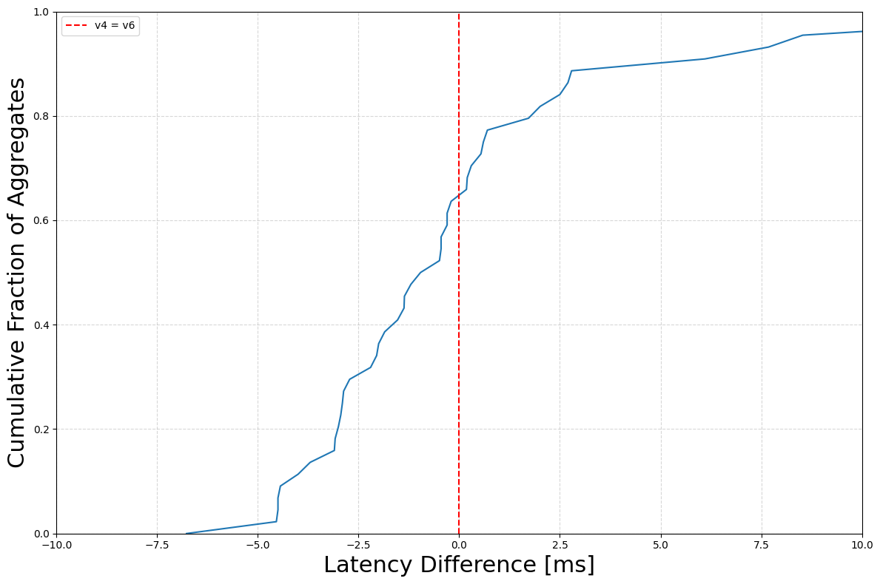

Slide 9
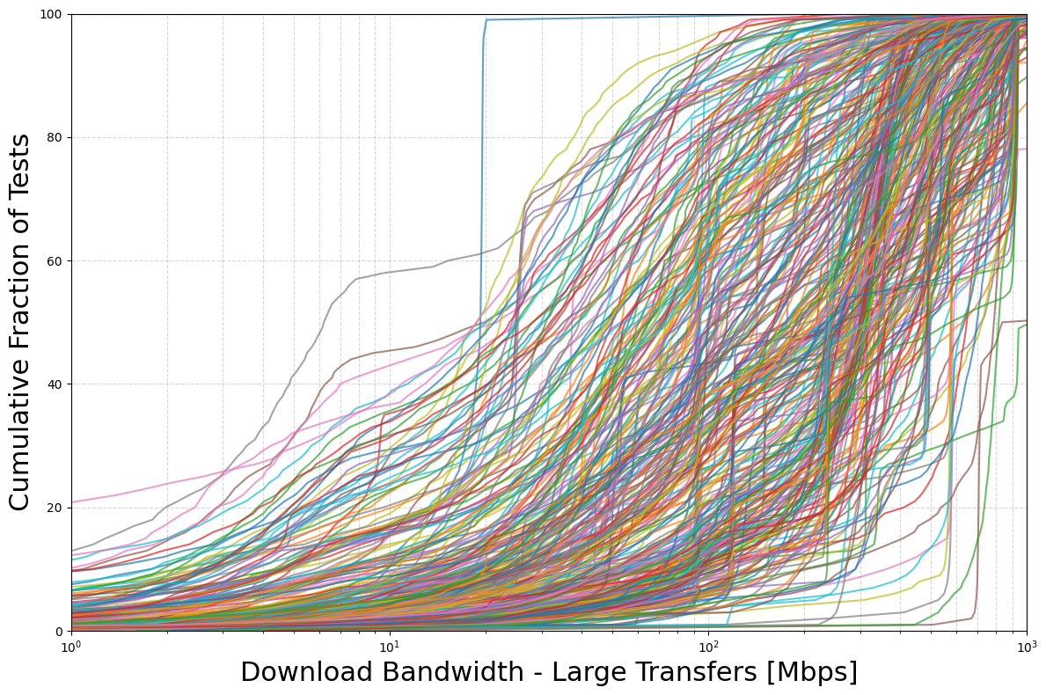

Slide 10
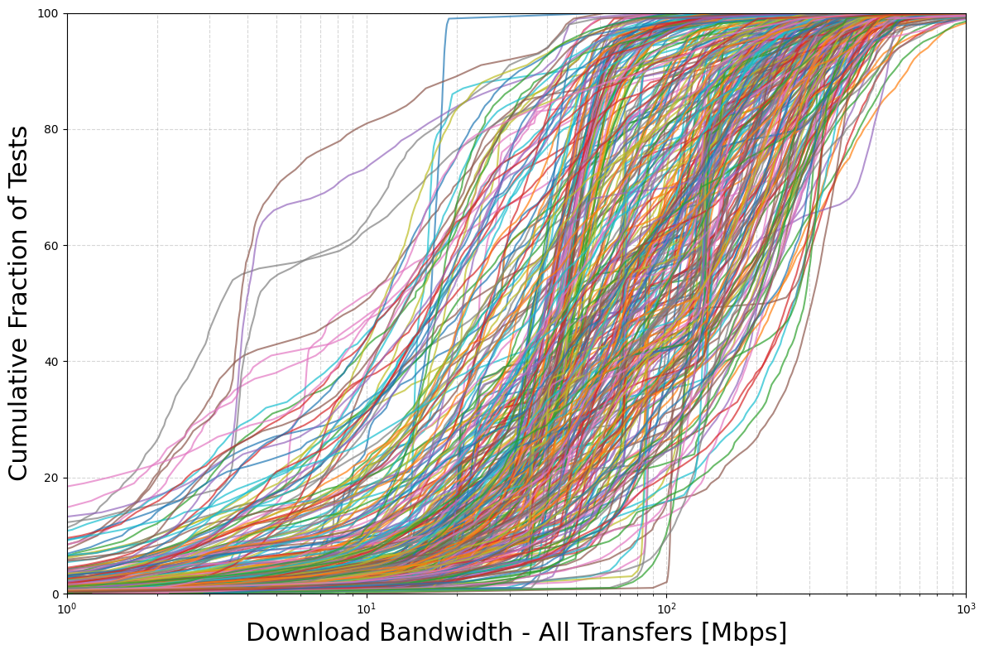

Slide 11
